Slide 1
Name :- Ravi Vipulbhai Dalwadi
Student ID :- 200507123
Assignment :- 4
Professor :- Diego Carbajal

Slide 2
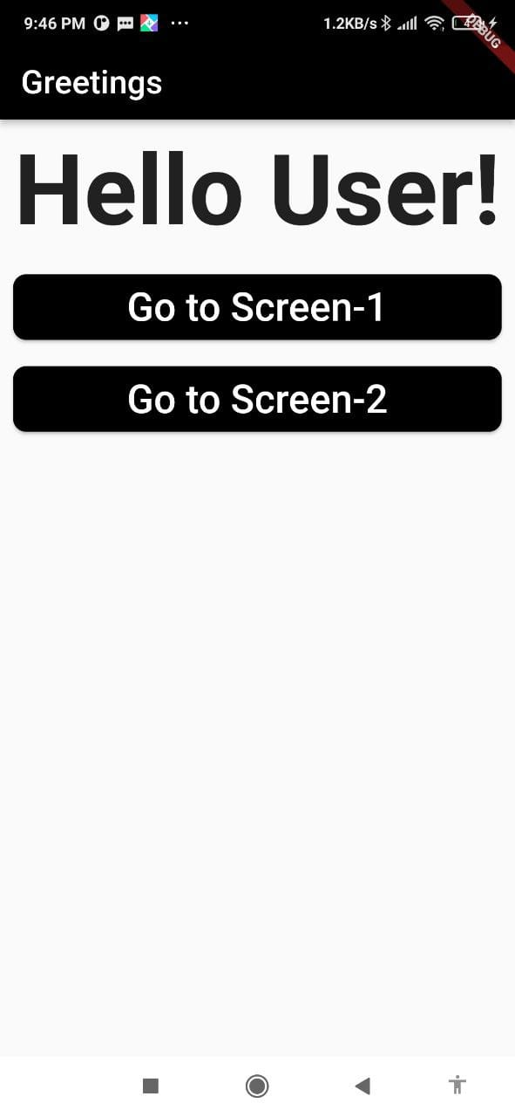
This is my Home Page screen.

Slide 3
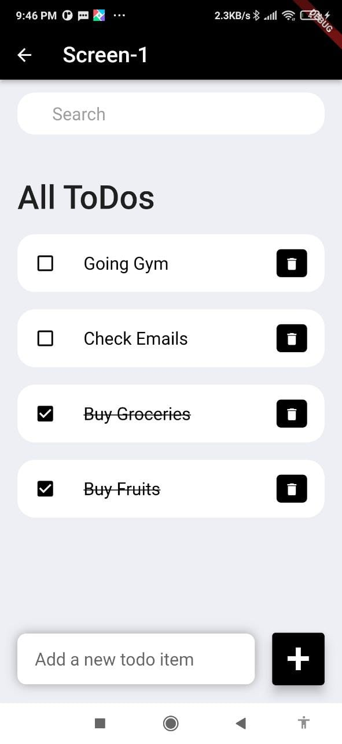
This is my screen 1, which contains a few activities.

Slide 4
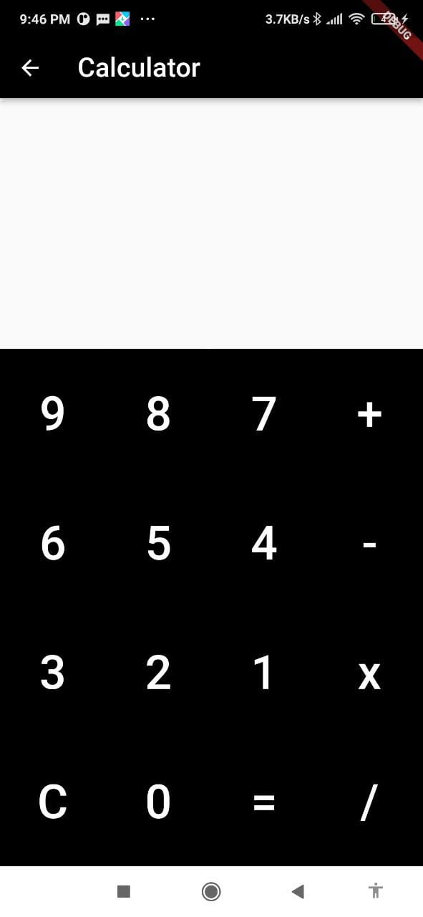
This is my screen 2 which shows a simple calculator.

Slide 5
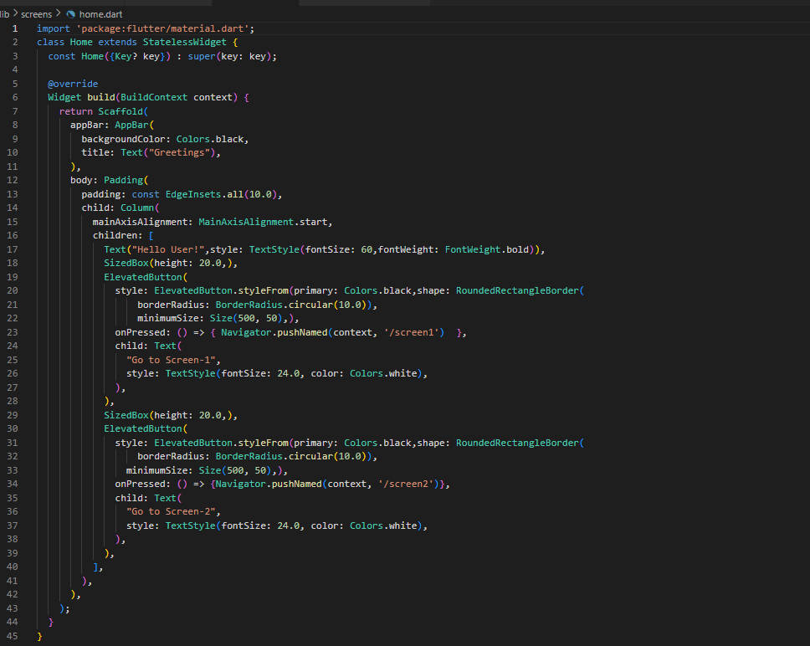
This is my Home screen code.

Slide 6
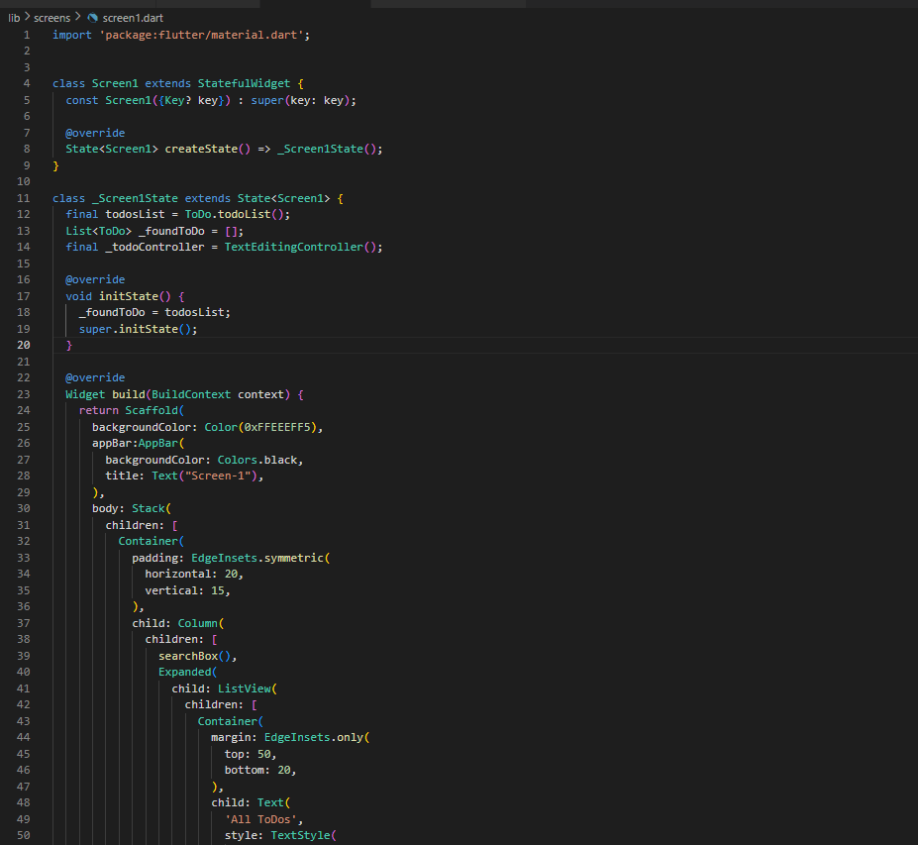
This is my screen 1 code which contains different widgets which I use for creating this Flutter app.

Slide 7
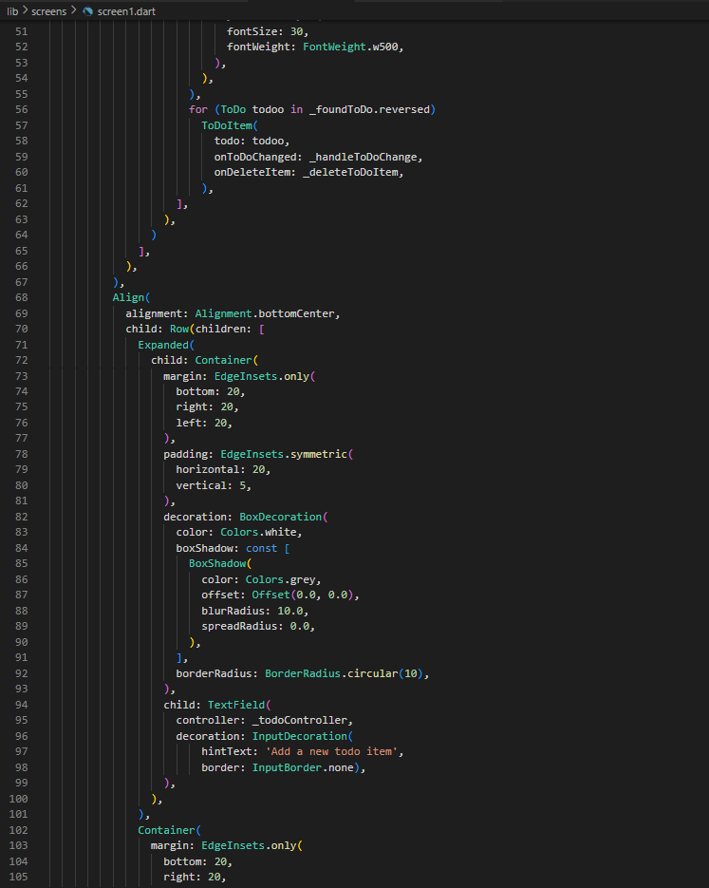

Slide 8
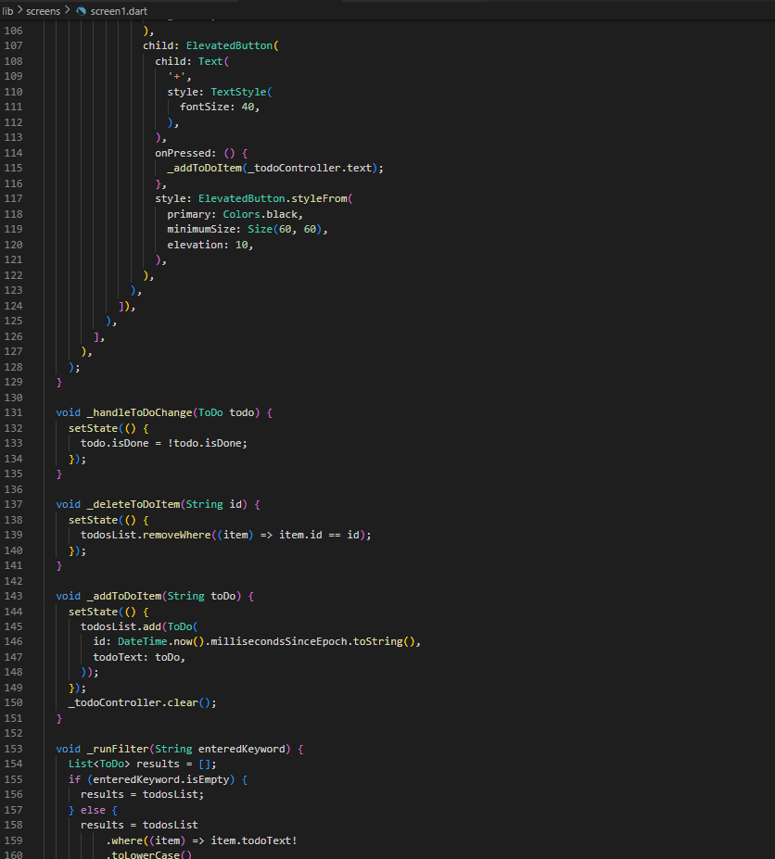

Slide 9
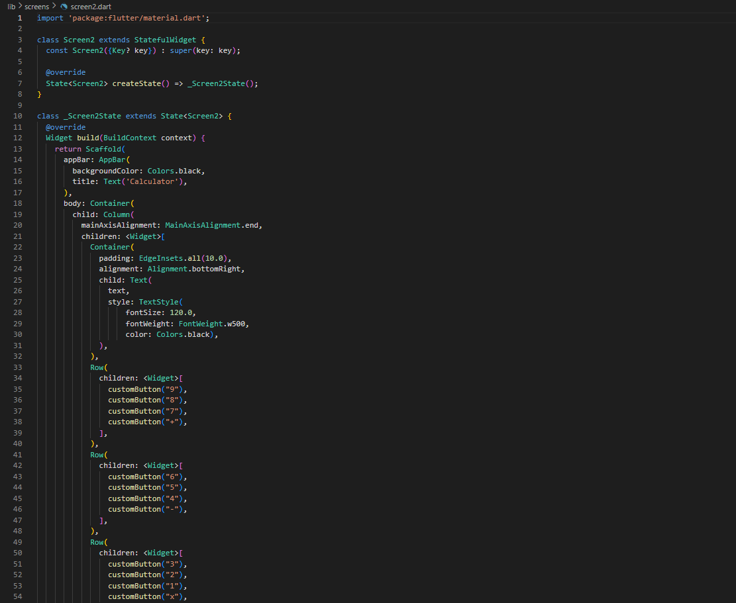
This is my Screen 2 code which also contains different widgets.

Slide 10
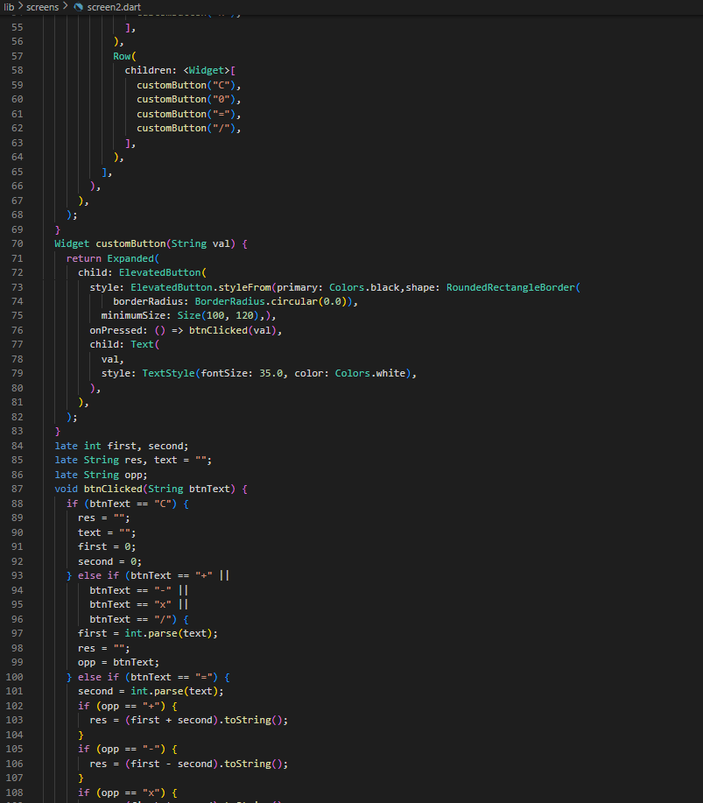

Slide 11
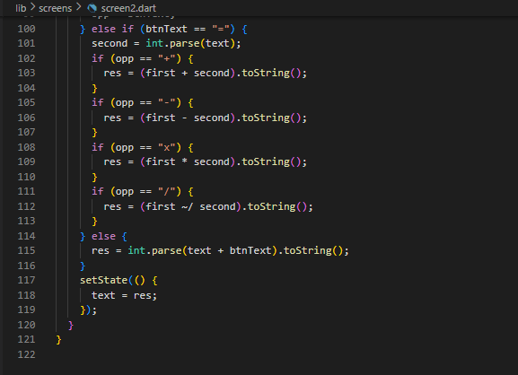

Slide 12
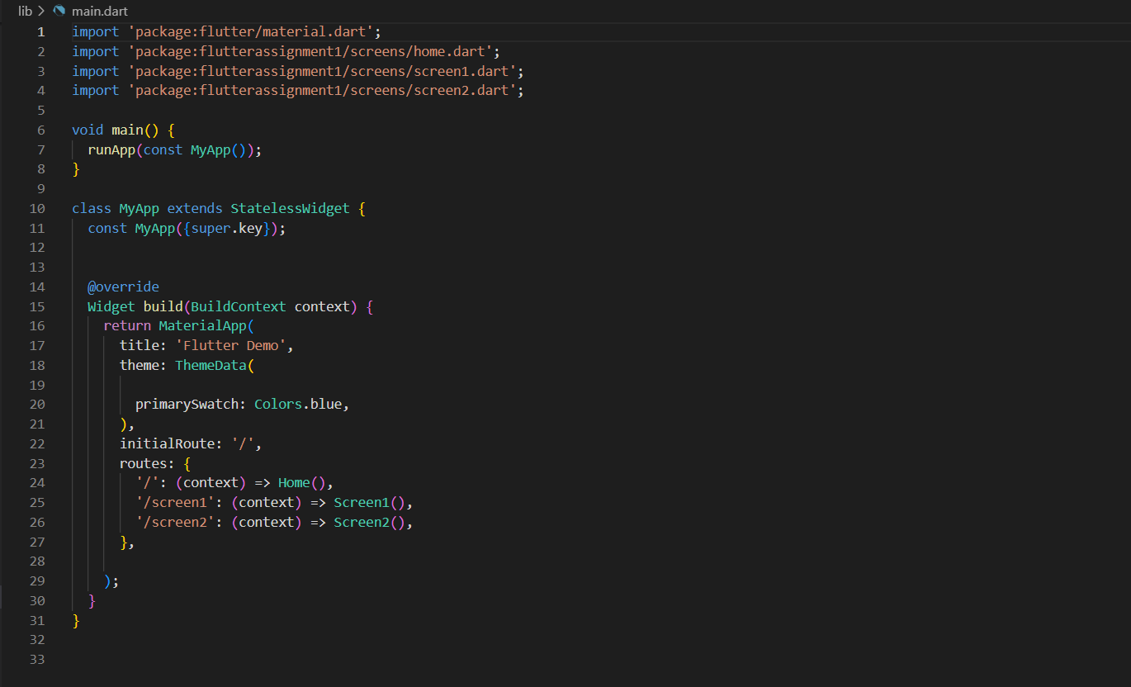
This is my Main Screen code.

Slide 13
Thank You

